Slide 1
“I’m more excited about ChatOps than any other idea in the last 10 years” – Guido P.
Notes:
Excited because ChatOps is transformative.

Slide 2
chat·ops /Chat äps/ noun A collaboration model that connects people, tools, process, and automation into a transparent workflow.

Slide 3
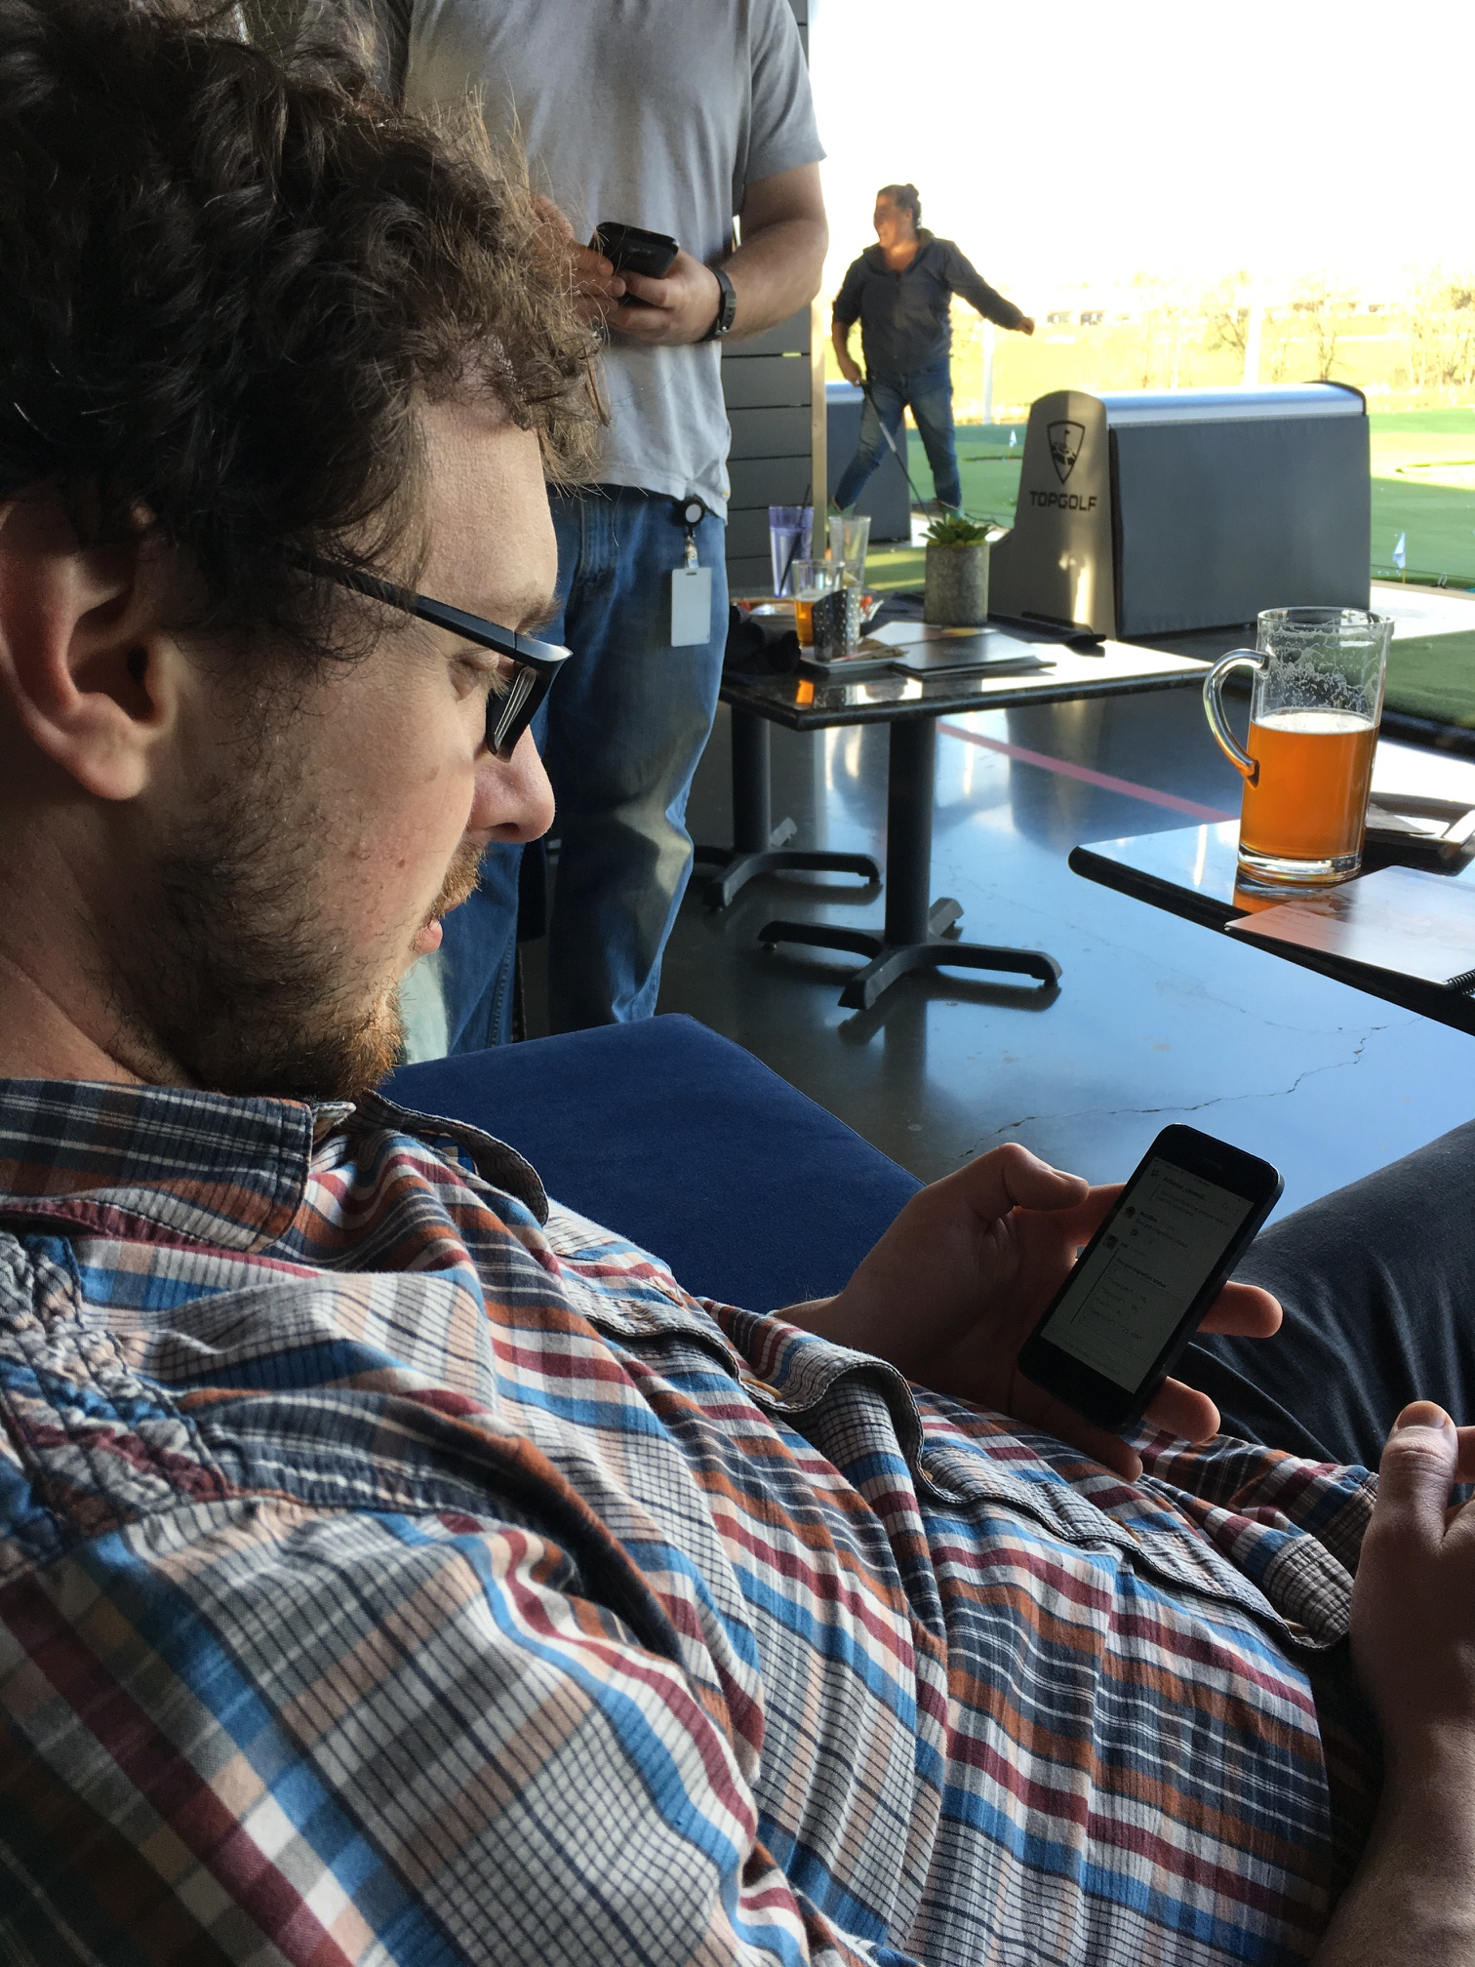
“Insert some quote here”
chat·ops
Notes:
ChatOps enables engineers to spend more time up front automating/testing and all members of the team can then monitor

Slide 4
on·board·ing /änˈbôrdiNG/ noun the action or process of integrating a new employee into an organization or familiarizing a new customer or client with one's products or services.

Slide 5
… New hire day 1
on·board·ing

Slide 6
… Immediate gratification
on·board·ing

Slide 7
… Autobuild Coffee Scripts
on·board·ing

Slide 8
… git, CI pipeline, Hubot
on·board·ing

Slide 9
fric·tion /frikSH(ə)n/ noun conflict or animosity caused by a clash of wills, temperaments, or opinions

Slide 10
… permissions
fric·tion

Slide 11
… dependencies
fric·tion

Slide 12
… training & experience
fric·tion

Slide 13
… context
fric·tion

Slide 14
… timezone & language
fric·tion

Slide 15
… organization structure
fric·tion

Slide 16
… tribal knowledge
fric·tion

Slide 17
trans·par·en·cy /tranˈsperənsē/ noun operating in such a way that it is easy for others to see what actions are performed. (implies openness, communication, and accountability)

Slide 18
… logging
trans·par·en·cy

Slide 19
… guardrails
trans·par·en·cy

Slide 20
… adhoc collaboration
trans·par·en·cy

